Slide 1
Today
Lecture 17: The Josephson effect --- fluctuations and quantum tunneling
Discussion of the Josephson effect in five parts:
Theory and phenomena
RSJ model
Magnetic field effects
Fluctuations and quantum tunneling
Beyond tunnel junctions (SNS, microbridges, SFS, ….)
Next time
Lecture 18: The Josephson effect --- beyond tunnel junctions --- SNS, microbridges, SFS, ….

Slide 2
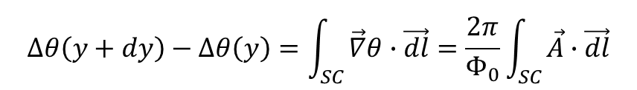
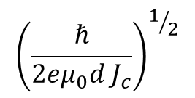

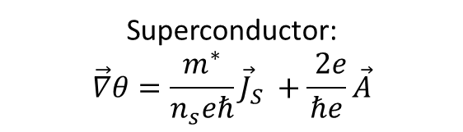
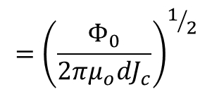

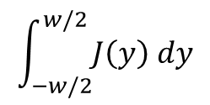



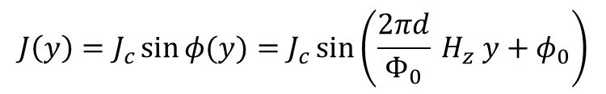

Magnetic Field Effects in extended junctions
x
J
$$λ_{L}$$
t
$$λ_{R}$$
y
B
y
$$y+dy$$
Superconductor:
$$\vec{∇}θ=\frac{m^{∗}}{n_{s}eℏ}{\vec{J}}_{S} +\frac{ 2e}{ℏe}\vec{A}$$
x
$$y$$
z
z
w_{z}
w
$$∆θ\left(y+dy\right)−∆θ\left(y\right)=\int_{SC}{\vec{∇}θ∙\vec{dl}}=\frac{2π}{Φ_{0}}\int_{SC}{\vec{A}∙\vec{dl}}$$
Integrate phase around path:
$$J\left(y\right)=J_{c}\sin{φ(y)}=J_{c}\sin\left(\frac{2πd}{Φ_{0}} H_{z} y+φ_{0}\right)$$
$$\int_{−w/2}^{w/2}{J\left(y\right) dy}$$
$${\left(\frac{ℏ}{2eμ_{0}d{ J}_{c}}\right)}^{1/2}$$
$${=\left(\frac{Φ_{0}}{2πμ_{o}dJ_{c}}\right)}^{1/2}$$
$I=wz$
$$λ_{J}=$$
$$\left(\frac{Φ_{0}c}{8π^{2}d}\right)\left(\frac{∂^{2}φ}{∂y^{2}}+\frac{∂^{2}φ}{∂z^{2}}\right)=J_{c}\sin{φ}+\left(σ_{0}+σ_{1}\cos{φ}\right)\left(\frac{ℏ}{2e}\right)\frac{∂φ}{∂t} +C_{A}\left(\frac{ℏ}{2e}\right)\frac{∂^{2}φ}{∂t^{2}}$$
“Sine-Gordon” equation

Slide 3


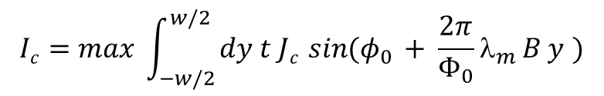
Josephson Interferometry: response to a magnetic field
x
magnetic thickness of barrier
barrier
thickness
φ₀
φ(y)
λ_{m} = b +2λ
λ_{m}
b
y
 B
Phase coherence  magnetic field induces a phase variation:
Uniform magnetic field ⇒
and small junction limit
 linear phase variation
Uniform junction ⇒
 Fourier transform
Fraunhofer diffraction pattern
Single-slit optical interference

Slide 4



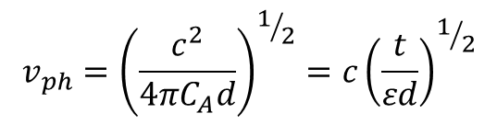



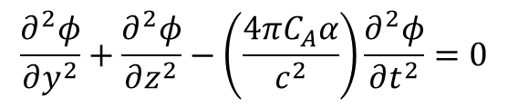


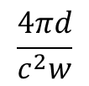
Phase Dynamics
Sine – Gordon equation:
depend on $\frac{∂φ}{∂t}$(V dependent)
$$\frac{∂^{2}φ}{∂y^{2}}+\frac{∂^{2}φ}{∂z^{2}}=\left(\frac{4πC_{A}d}{c^{2}}\right)\frac{∂^{2}φ}{∂t^{2}}+\left(\frac{4πd}{c^{2}}\right)\left(σ_{o}+σ_{1}\cos{φ}\right)\frac{∂φ}{∂t}+{\left(\frac{1}{λ_{J}}\right)}^{2}\sin{φ}$$
2nd special case: Ignore supercurrent & damping
$$\frac{∂^{2}φ}{∂y^{2}}+\frac{∂^{2}φ}{∂z^{2}}−\left(\frac{4πC_{A}α}{c^{2}}\right)\frac{∂^{2}φ}{∂t^{2}}=0$$
Solution – propagating modes at velocity $v_{ph}$
$$t \sim 10Å$$
$$v_{ph}={\left(\frac{c^{2}}{4πC_{A}d}\right)}^{1/2}=c{\left(\frac{t}{εd}\right)}^{1/2}$$
$$d \sim 100 nm$$
$$v_{ph}\sim 0.01c−0.10 c$$
$$ε \sim 1−10$$
Junction acts like a transmission line with a characteristic phase velocity
$$\frac{εw}{4πt}$$
$$\frac{4πd}{c^{2}w}$$
per unit length
$$C=$$
$L=$

Slide 5

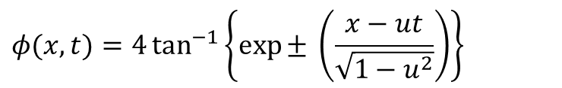
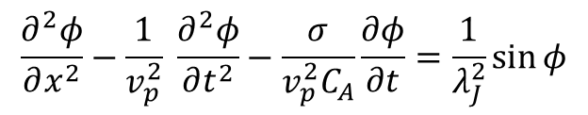
Junction Dynamics
Fluxon Dynamics
Sine – Gordon equation:
ϕ
$$\frac{∂^{2}φ}{∂x^{2}}−\frac{1}{v_{p}^{2}} \frac{∂^{2}φ}{∂t^{2}}−\frac{σ}{v_{p}^{2}C_{A}}\frac{∂φ}{∂t}=\frac{1}{λ_{J}^{2}}\sin{φ}$$
x
Solutions:
$$φ\left(x, t\right)=φ\left(x−ut\right)$$
$$φ(x,t)=4\tan^{−1}\left\{{\exp{±}}^{ }\left(\frac{x−ut}{\sqrt{1−u^{2}}}\right)\right\}$$
plasma waves (periodic waves propagating)
Traveling waves --- solutions (particle-like modes, localized, collisions gives time-delay but no change in shape or spread
Standing waves (finite junctions)
breather modes – vortex/antivortex pairs bound
fluxon oscillations – mutually propagating/reflecting

Slide 6
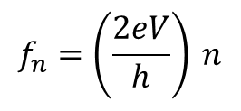




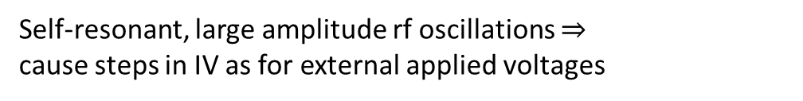
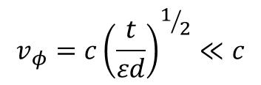





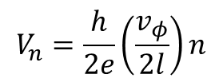
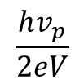
(2) Resonant modes
$$C \sim \frac{1}{t}$$
Josephson junction can be regarded as a transmission line
electric field
Finite size junction ⟹ resonant cavity
magnetic field
$$L \sim d=t+2λ_{L}≫t$$
$$ℓ$$
$$v_{φ}=c{\left(\frac{t}{εd}\right)}^{1/2}≪c$$
velocity
$$f_{n}={\left(\frac{2eV}{h}\right)}_{ }n$$
V $⇒$ Josephson oscillator harmonics
Characteristic wavelength
$$λ_{n}=$$
$$\frac{v_{φ}}{f_{n}}$$
$$=$$
$$\frac{hv_{p}}{2eV}$$
$$\frac{ 1}{n}$$
I
$$V_{n}=\frac{h}{2e}\left(\frac{v_{φ}}{2l}\right)n$$
Resonances when $λ_{n}=2ℓ ⇒$
Self-resonant, large amplitude rf oscillations $⇒$
cause steps in IV as for external applied voltages
V
Fiske modes – source of structure in IV’s
In general, complex behavior, subharmonics, etc.

Slide 7
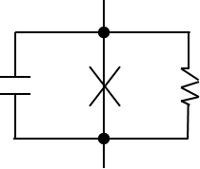
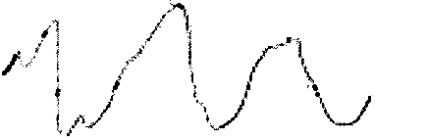
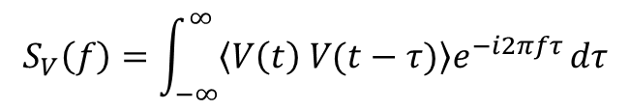





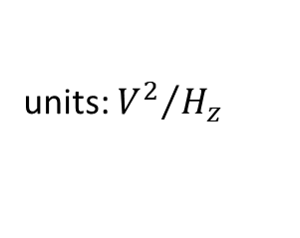
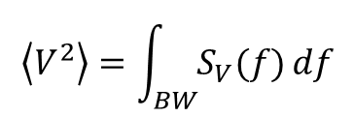

Junction noise sources
or more general
V(t)
$$τ$$
$S_{V}=$ power spectral density
$$S_{V}\left(f\right)=\int_{−∞}^{∞}{\left\langle V\left(t\right) V(t−τ)\right\rangle e^{−i2πfτ}}dτ$$
t
Reminder
auto-correlation function
$$\left\langle V^{2}\right\rangle =\int_{BW}{S_{V}(f)}df$$
units: ${V^{2}}/{H_{z}}$
We will consider many types of noise:
1. White noise
$S_{V}$ = constant
2. Shot noise
$S_{V}$ = constant
3. 1/f noise
$S_{V}$ ~ 1/f
4. Chaos
5. Quantum noise
$S_{V}$ ~ f
Talk about this with SQUIDs --- set the quantum limit for detction

Slide 8



1. White noise --- random no correlation unless $τ=0$
$$\left\langle VV\right\rangle$$
$$S_{V}$$
white noise
(independent of f)
τ
f
Resistor $S_{V}\left(f\right)=4k_{B}TR$
“Johnson noise”

Slide 9


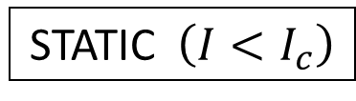



Effects of Thermal Fluctuations on IV’s
Current-biased RSJ
Add Johnson (current) noise in the junction resistance as a contribution to the bias current  jiggles the sloe of the washboard potential
$$I_{N}$$
$$I$$
$$\frac{4k_{B}T}{R}$$
units: ${A^{2}}/{H_{z}}$
Current noise: $S_{I}=$
STATIC $\left(I<I_{c}\right)$
Thermal fluctuations can induce transitions over barriers in JJ washboard potential

Slide 10
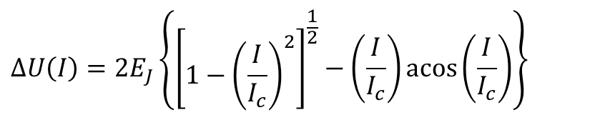
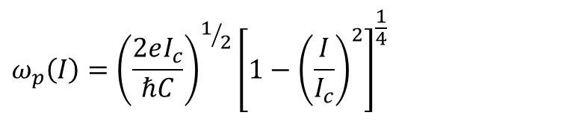
“Thermal activation”
Barrier height:
$$ΔU\left(I\right)=2E_{J}\left\{{\left[\begin{matrix} \\ 1−{\left(\frac{I}{I_{c}}\right)}^{2}\end{matrix}\right]}^{\frac{1}{2}}−\left(\frac{I}{I_{c}}\right)\operatorname{acos}\left(\frac{I}{I_{c}}\right)\right\}$$
Plasma (small oscillation) frequency:
$$ω_{p}\left(I\right)={\left(\frac{2ⅇI_{c}}{ℏC}\right)}^{1/2}{\left[1−{\left(\frac{I}{I_{c}}\right)}^{2}\right]}^{\frac{1}{4}}$$

Slide 11
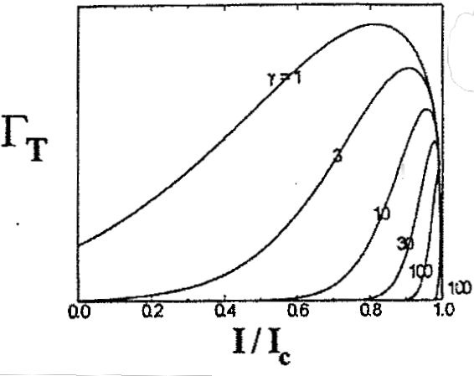
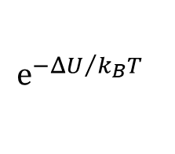
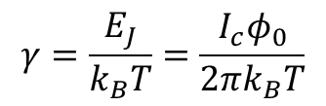



Escape rate:
Probability per time of thermal activation
$$\left(\frac{ω_{p}}{2π}\right)$$
$$ⅇ^{−ΔU/{k_{B}}T}$$
$$Γ_{T}\left(T\right)=$$
$$γ=\frac{E_{J}}{k_{B}T}=\frac{I_{c}φ_{0}}{2πk_{B}T}$$
Key parameter:
UNSHUNTED JUNCTIONS
$$\left\langle I_{c}\right\rangle <I_{c}$$

Slide 12
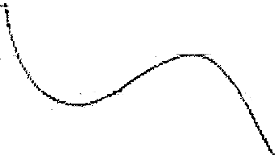

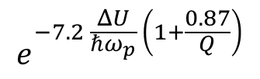



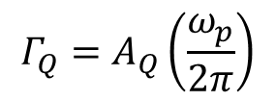
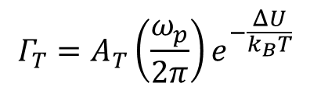
Quantum Effects
Test of QM in a microscopic system
Static Consider quantum tunneling from well
MQT - Leggett
$$Γ_{T}=A_{T}\left(\frac{ω_{p}}{2π}\right)ⅇ^{−\frac{ΔU}{k_{B}T}}$$
where $Q=ω_{P}RC$
Rate flattens out at low T
$$Γ$$
$$Γ_{Q}=A_{Q}\left(\frac{ω_{p}}{2π}\right)$$
$$ⅇ^{−7.2 \frac{ΔU}{ℏω_{p}} \left(1+\frac{0.87}{Q}\right)}$$
I
$$T$$
$$T_{x}$$
Absence of damping (Q large), MQT dominates for $ℏω_{p}=7.2k_{B}T$
Damping suppresses tunneling rate --- “watched pot” effect from measurements
MQT seems natural in the RCSJ model but until observed there was no consensus on whether this was valid --- the “phase particle” represents the coherent state of many electrons

Slide 13



SHUNTED JUNCTIONS
$\left\langle V\right\rangle >0$, for $<I_{c}$
$$I$$
Noise-rounding
Premature escape from the well into the next well, etc.
$$V$$

Slide 14

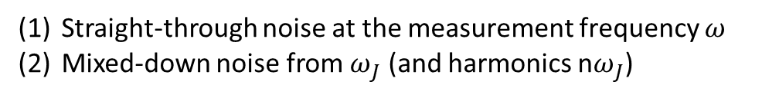

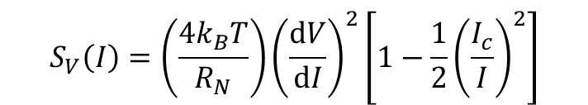
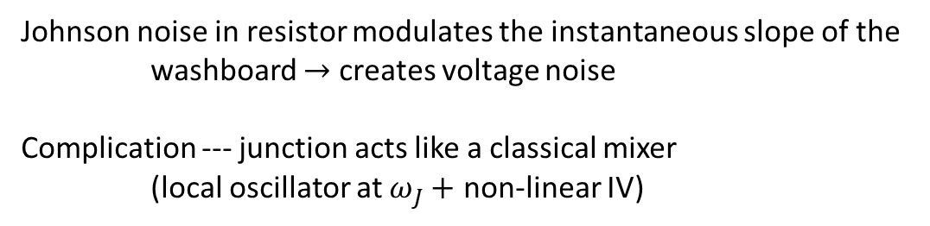
Effects of Thermal Fluctuations on Voltage Noise
DYNAMIC $\left(I>I_{c}\right)$
Free-running state $\left\langle V\right\rangle >0$
Johnson noise in resistor modulates the instantaneous slope of the washboard $→$ creates voltage noise
Complication --- junction acts like a classical mixer
(local oscillator at $ω_{J}+$ non-linear IV)
$$S_{V}\left(I\right)=\left(\frac{4k_{B}T}{R_{N}}\right){\left(\frac{ⅆV}{ⅆI}\right)}^{2}\left[1−\frac{1}{2}{\left(\frac{I_{c}}{I}\right)}^{2}\right]$$
Straight-through noise at the measurement frequency $ω$
Mixed-down noise from $ω_{J}$ (and harmonics n$ω_{J}$)

Slide 15



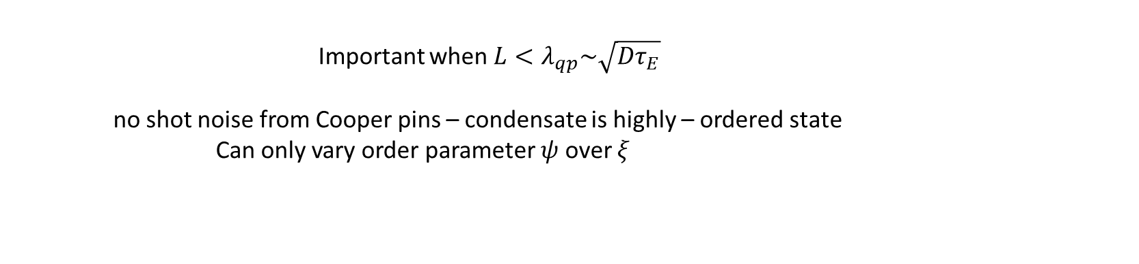


2. Shot noise – random arrival time of qp’s in tunneling structure
Important when $L<λ_{qp}\sim \sqrt{Dτ_{E}}$
no shot noise from Cooper pins – condensate is highly – ordered state
Can only vary order parameter $ψ$ over $ξ$
quasiparticles exhibit shot noise (derive from tunneling Hamiltonian)
$$S_{I}\left(v,V\right)=ⅇ\left\{{\overline{I}}_{N}\left(v+\frac{hν}{ⅇ}\right)\coth{\frac{eV+hv}{2k_{B}T}}\right.\left.+{\overline{I}}_{N}\left(V−\frac{hv}{ⅇ}\right)\coth{\frac{eV−hv}{2k_{B}T}}\right\}$$
${\overline{I}}_{N}\left(V\right)=$ dc current at voltage $V \sim GV$
$$V±\frac{hv}{ⅇ}$$
Fluctuations at V came from changes in current at (absorb/emit photon);
$$I=f_{L}\left(1−f_{R}\right)−f_{R}\left(1−f_{L}\right)=f_{L}−f_{R}$$
R  L
L  R
$$L→R$$
$$R→L$$

Slide 16
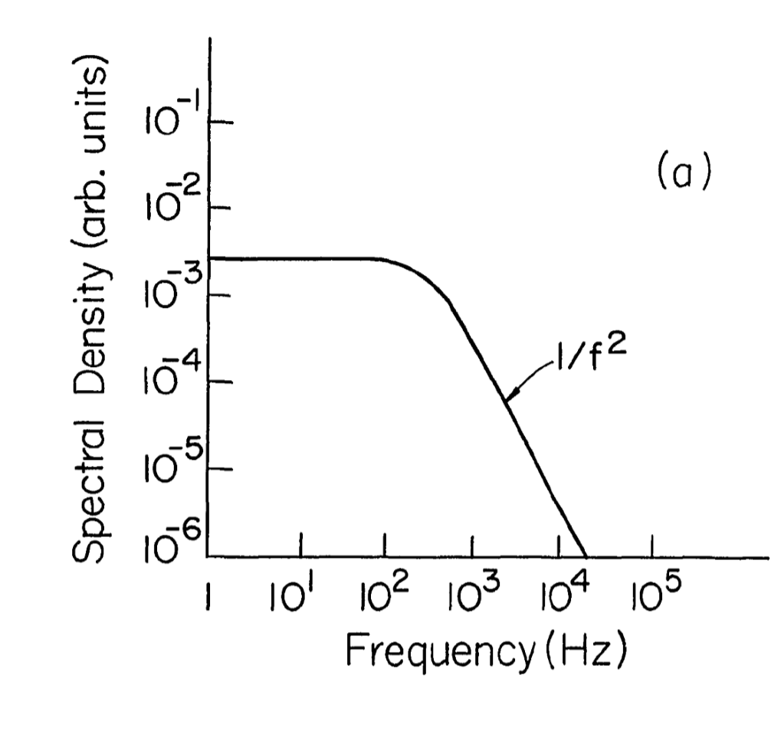
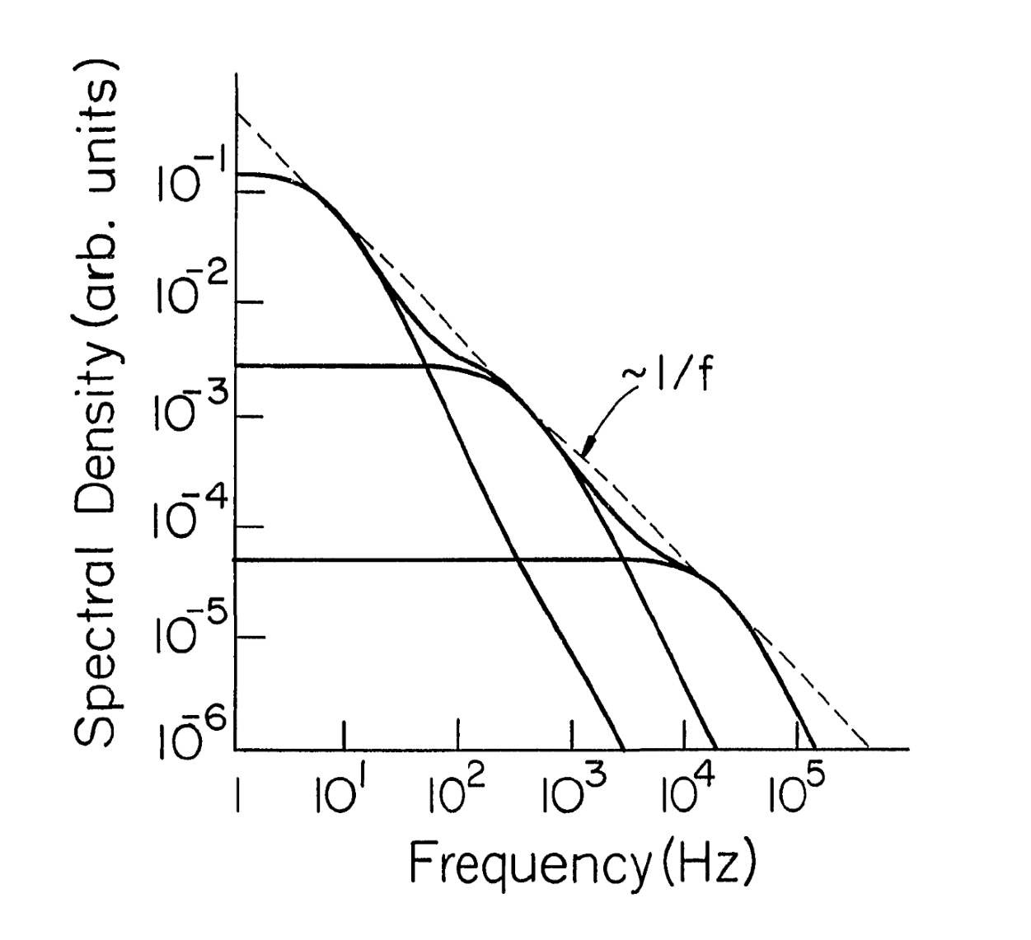



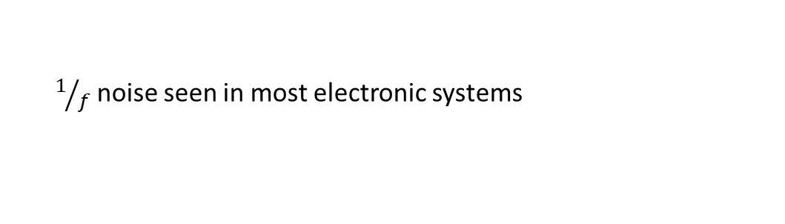



3. 1/f noise (low-frequency noise)
Arises from discrete fluctuators (TLS = two-level systems) with a uniform distribution of energy (Dutta-Horn model)
$$S_{V}$$
I
$$f$$
V
$$\log{P(τ\text{)} }$$
$$f_{c}$$
t
$$τ$$
Measure $S_{V}$ vs $f$: find $1/f$ contribution
$1/f$ noise seen in most electronic systems
Not a universal law
UIUC expert is Mike Weissman
Single fluctuator
Multiple fluctuators

Slide 17
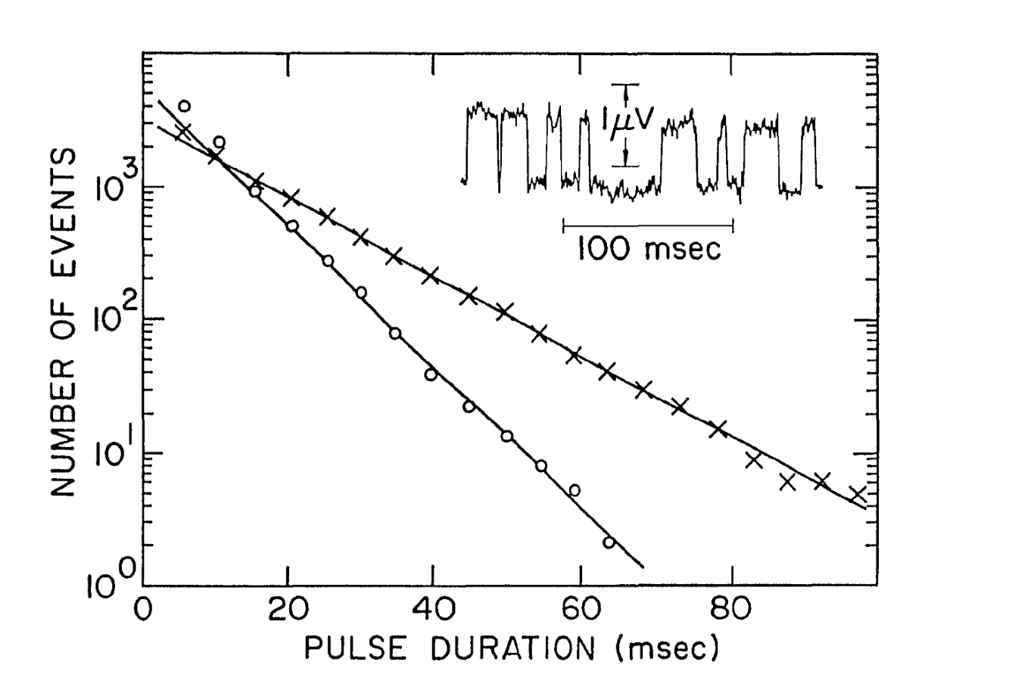

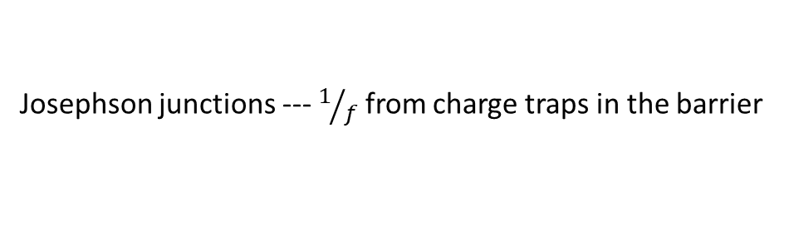
Josephson junctions --- $1/f$ from charge traps in the barrier
Blocks charge over a region --- reduces $I_{c}$
Direct evidence: observation of single trap dynamics
TOP view
SIDE view

Slide 18

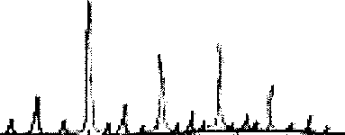


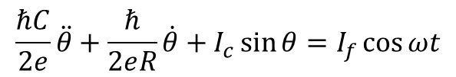


4. Chaos – “turbulence”
Deterministic equations ⇒ random behavior
Criteria:
(1) non-linear DE
(2) two competing characteristic frequencies
Features:
bifurcations
broadband noise
$$\frac{ω_{J}}{\left(2^{rJ}\right)}$$
subharmonic spikes
Driven RSJ =
Broadband - noise
$$\frac{ℏC}{2ⅇ}\ddot{θ}+\frac{ℏ}{2ⅇR}\dot{θ}+I_{c}\sin{θ}=I_{f}\cos{ωt}$$
$$S_{V}(f)$$
Josephson frequency
drive frequency
$$f/{f_{J}}$$
0 1 2 3 4
How to get a second frequency?
$$ω_{J}$$

Slide 19







RSJ with an external resistor coupled through an inductor
L
C
R
$$I=C\dot{V}+I_{qp}+I_{S}+I_{c}\sin{θ}$$
$$=\frac{ℏ}{2e}\dot{θ}=I_{S}R+{\dot{I}}_{S}L$$
$$V$$
Frequencies: $ω_{J}$ and $ω_{LC}$
Consequences: noise from phase evolution alone, without external noise sources

